Slide 1
Fastest Supply Chain
Customer Interface
Browse items from multiple stores with detailed product information
Search functionality by item name and category
Real-time stock availability indicators
Shopping cart management with add/remove functionality
Multiple payment options (Card, UPI, Cash on Delivery)
Order history and real-time order tracking
Delivery System
Real-time order status updates (collected, in transit, delivered)
Delivery history tracking
Location-based assignment and tracking
Optimized delivery assignment for 2 delivery agents
Route planning for multi-store pickups
Finds the shortest path for delivery agents by considering their current location, store positions, customer addresses, and order status. It pre-computes distances for faster calculations.
Store Management
Dedicated dashboards for each of the 3 store managers
Inventory management (add new items, update existing items)
Price and discount management
Stock level monitoring and updates
Order processing and status updates
Store-specific order history and analytics
Admin Dashboard
Comprehensive system overview
Monitor all stores, orders, and delivery agents
Track system performance and order statistics
Authentication & Security
Secure login system with role-based access control
Password hashing using bcrypt for enhanced security
Session management for persistent user experience
Notes:
We've developed a quick commerce delivery platform similar to Blink-it, focusing on efficient delivery of groceries and everyday essentials. The platform connects customers, store managers, and delivery agents through an intuitive web interface built with Flask and Python. The system features order tracking, inventory management, and a route optimization algorithm for efficient deliveries.
Route Optimization Algorithm
The platform features a sophisticated route optimization algorithm that:
Calculates the most efficient path for delivery agents to collect items from multiple stores
Considers current location of delivery agents, store locations, and customer address
Prioritizes available drivers and minimizes total travel distance
Handles edge cases like network disruptions and unavailable paths
Pre-computes distances using Floyd-Warshall algorithm for faster route determination
For smaller orders (≤4 stores), evaluates all possible routes to find the absolute optimal path

Slide 2
Technologies Used
Python with Flask: The core backend language and web framework, enabling rapid development of robust web applications and efficient implementation of complex algorithms like route optimization.
Jinja2 Templating: Integrated with Flask for dynamic HTML rendering, allowing seamless integration of backend data with frontend presentation and enhancing code reusability.
Bootstrap and JavaScript: Employed for responsive frontend design and interactive user experience, creating an intuitive interface across different devices and screen sizes.
Flask-Login and Flask-Bcrypt: Implemented for secure user authentication, session management, and password hashing, providing robust security features for user data protection.
WTForms and Flask-WTF: Leveraged for form validation and CSRF protection, streamlining data collection and ensuring secure form submissions throughout the application.
NetworkX and Custom Algorithms: Utilized for graph operations and implementation of sophisticated route optimization algorithms, crucial for the delivery system's efficiency.
Pytest and Flake8: Comprehensive testing framework and linting tool, ensuring high code quality, maintainability, and reliability through extensive test coverage and style enforcement.

Slide 3
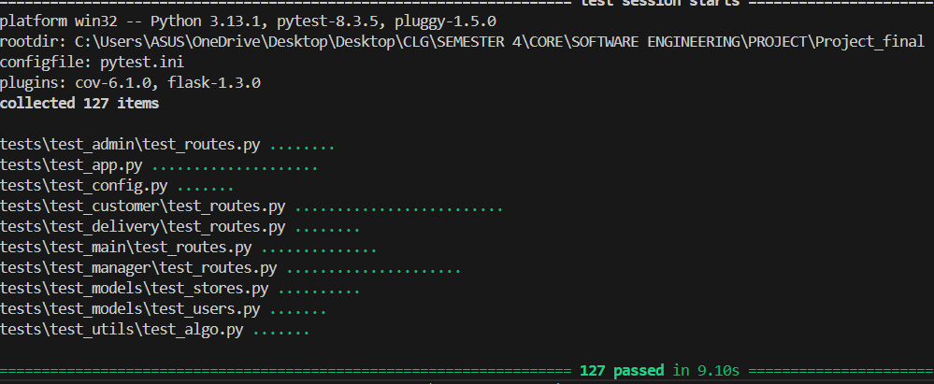
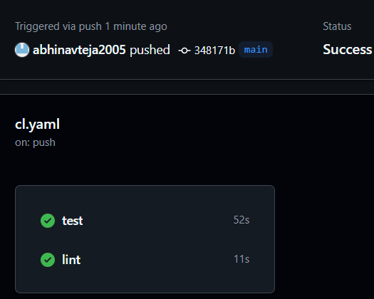
Testing
Integration of CI/CD Pipeline
Challenges faced
Backend Challenges
First-time experience with Python and Flask required steep learning curve
Organizing code into proper directory structure and maintaining clean architecture
Implementing complex algorithms like route optimization with NetworkX
Frontend Challenges
Limited styling expertise led to heavy reliance on Bootstrap and AI assistance
Jinja2 templating integration with backend data structures caused synchronization issues
Debugging template rendering problems required running in debug mode to track errors
Testing Challenges
Managing global state between tests caused unexpected failures in test suite
Test isolation issues when running all tests together versus individually
Flash message verification in testing environment required special handling
CSRF token management in form submission tests added complexity
Mocking external dependencies and complex algorithms for unit testing

